Slide 1
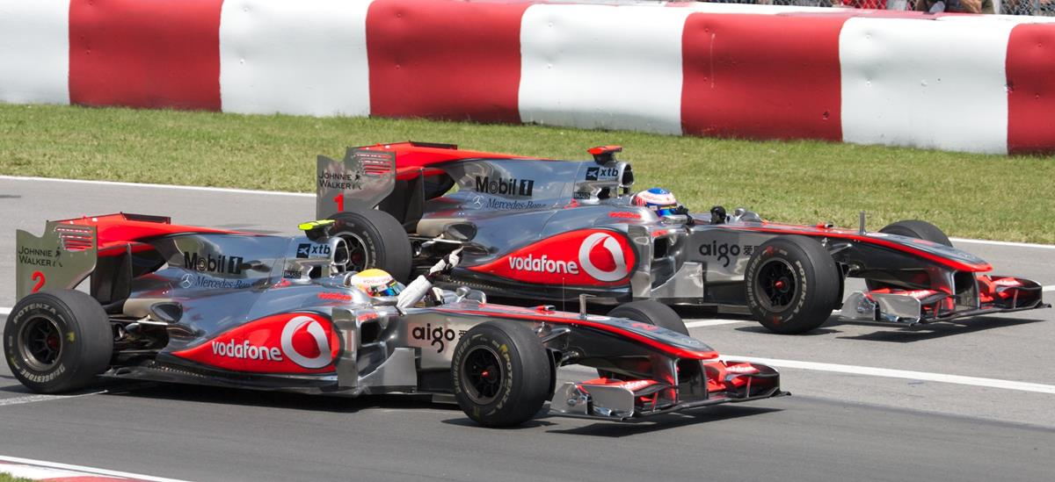
Factors affecting F1 Racing
By
Tom Cahill
John Ng
Praveena MS
Andrea Sciubba

Slide 2
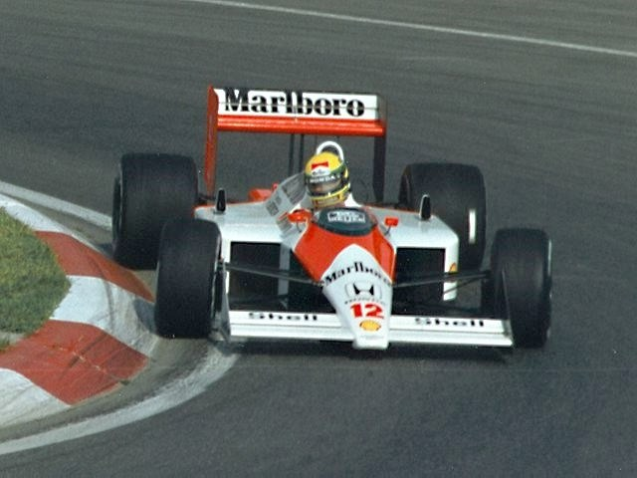
Our Story
The governing body of F1 racing, the FIA (Fédération Internationale de l'Automobile), has tasked data analysts from "F1 Fanatics" to review data from 1950 until 2021 to investigate factors affecting F1 races to help them grow the sport and better plan races for the future.

Slide 3

F1 Racing 101
Teams “constructors” have two race drivers for each race during the championship
Drivers compete individually and their points are also combined for their team points to go towards a constructors championship
Each race, drivers participate in a series of qualifying races to determine their start position on the grid; the faster the lap times, the better starting position
There are rules for the entire season and individual races e.g. the number of tyres, engines and modifications allowed, and minimum pit stops required in each race
Number of races vary each year; minimum 7 in 1950, maximum 20 in 2012, now there are generally 19 to 20
Over the 71 years, races have occurred in 32 countries at 77 racing circuits

Slide 4
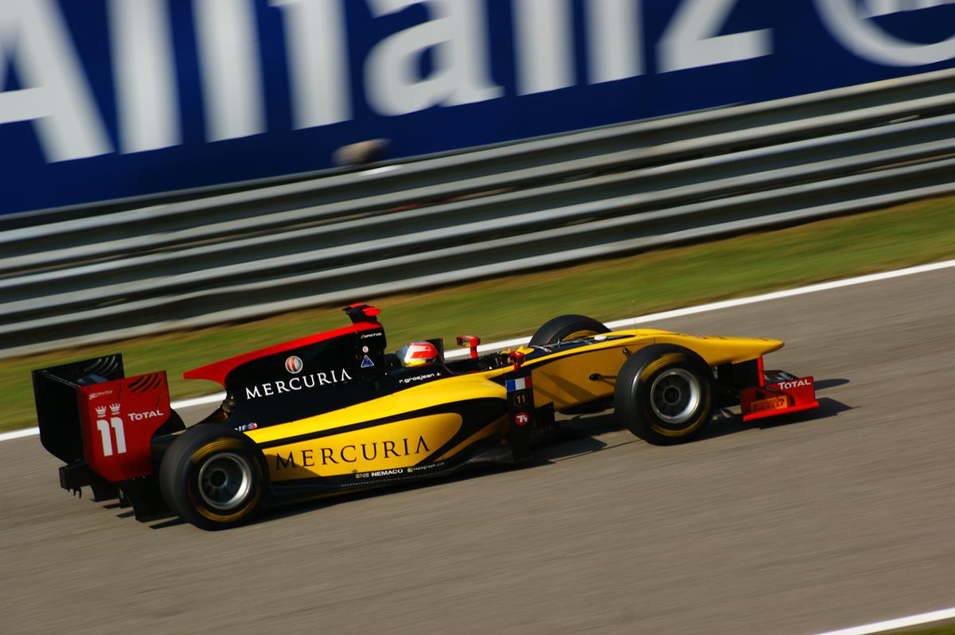
How and what we did
Ergast Developer API
http://ergast.com/mrd/
Data from 1950 to 2021 – used entire year range
Imported 13 CSVs and merged into one dataframe
Number of races in each country
Country of origin for constructors
Nationality of drivers
Starting grid position
Pit stops
Fastest laps
Fastest lap speed

Slide 5
Number of races in each country

Slide 6
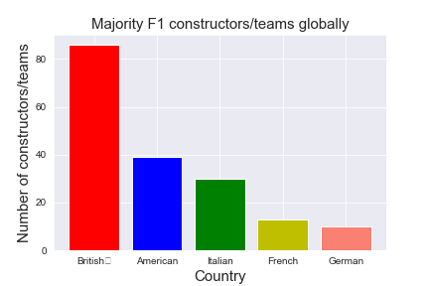
Country of origin for constructors
Number of constructors based in each country
Presented top 5 countries
British constructors most dominant followed by America, and then European countries

Slide 7
Country of origin for drivers

Slide 8
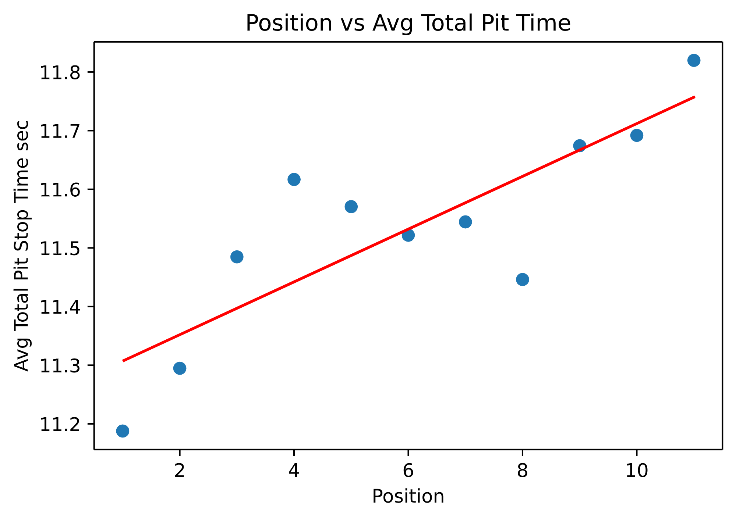
Pit stops
Average total pit stop time compared to finishing position
Filtered to finished top 10 positions
Strong positive linear correlation positions 1 to 4, then no consistent trend
Reasons: mechanical failures, crashes, pit stop crew error

Slide 9
Number of pit stops per race

Slide 10
Fastest laps

Slide 11
Fastest lap speed

Slide 12
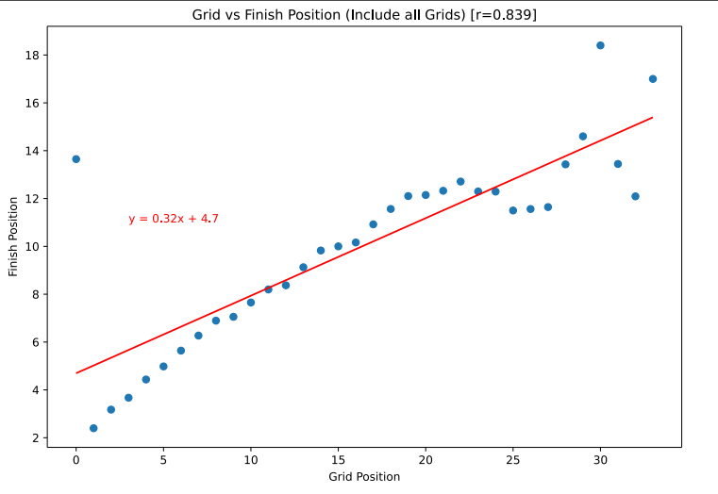
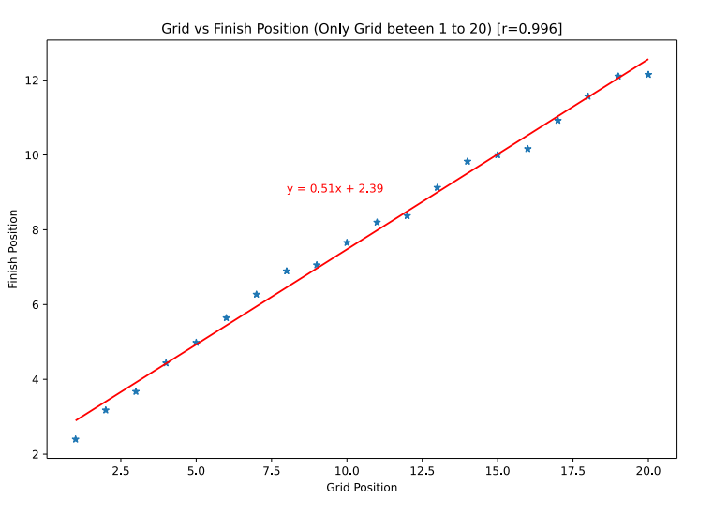
Grid position
Starting position on grid compared to finished position
Strong positive linear correlation for positions 1 to 20, then no consistent trend
Reasons: race originally had 34 grid positions then changed to 20, therefore more data collected

Slide 13
API

Slide 14
Discussion

Slide 15
Challenges

Slide 16
Q+A

